Slide 1
NAWS UPDATE

Slide 2
IMPORTANT INFORMATION & DATES
NA WAY MAGAZINE:
Resubscribe – www.na.org/subscribe
LIVING CLEAN PROJECT:
  Approval draft ready end of April. Draft copy purchase price from NAWS is $8.50.
LITERATURE SURVEY:
Complete on line by April 30, 2011. Website address: www.na.org/litsurvey
WCNA 34:
  Pre-register on line @ www.na.org/wcna34
SERVICE SYSTEM PROJECT:
Information available on line @ www.na.org/servicesystem

Slide 3
IMPORTANT INFORMATION & DATES
LITERATURE:
Literature prices will raise July 2011
New Products:
Sixth Edition Spanish Basic Text
Tri-plate medallions – pearl/pink & black/silver
Gift Edition – It Works How and Why

Slide 4
Fiscal update
NAWS
    Fiscally is able to operate up to 58 days
    Operating with bare-bones staff: lost 7 employees and not replacing – 15% reduction for projects & services
  World Board Members did not meet in March
  Donations and literature sales are down

Slide 5
Service system input
63 individuals
6 groups
27 RSC’s
18 workshops
10 countries:
  Finland Sweden
  Honduras United States (30 states)
  Mexico United Kingdom
  Panama Venezuela
  South Africa Canada (3 provinces)

Slide 6

Service System Update

Slide 7
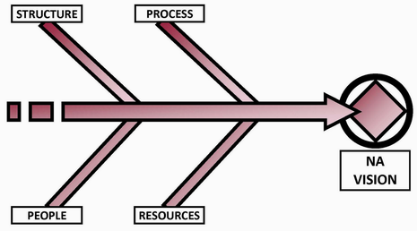
The components of a system

Slide 8
Project background
Commonly experienced, ongoing challenges in NA service:
  Ineffective communication
  Insufficient resources
  Frustrated trusted servants
  Poor atmosphere of recovery in service meetings

Slide 9
Project Background
NAWS restructured in the late 90s, but we haven’t holistically examined local services – until now
Current structure designed before the Twelve Concepts were adopted in 1992
Our hope is for a system that more closely embodies the principles of the Twelve Concepts

Slide 10

GSU
The group support unit (GSU) is intended to help groups better carry the message within their meetings by separating out the group support function from the “business” of NA and creating a body whose purpose is helping groups

Slide 11
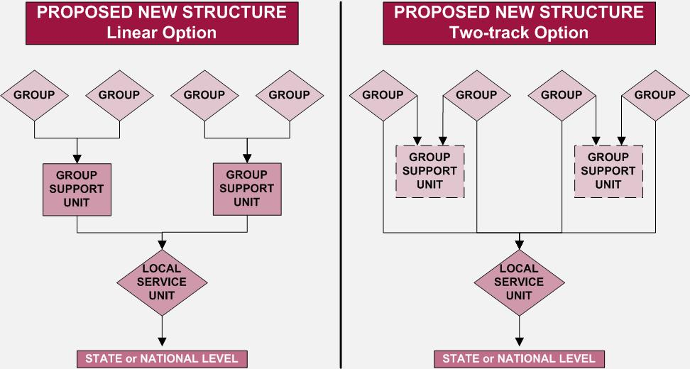
Gsu: linear or two-track

Slide 12
Group support and local services
“Linear” vs “Two-track” has been discussed and straw polled as though the new model will be one or the other
The system could be both/either, with rationale provided about why a local community may choose.

Slide 13
What happens at the gsu
Informal training & mentoring
Discussion of group business, group sharing
Welcome & outreach to new groups & members
Orientation & intro to service
Informal information sharing
Some limited, informal service (putting up fliers, supporting outreach or H&I)
Open attendance; at least one designated delegate from each group

Slide 14

Local service unit
The LSU is the “workhorse” of the service system, responsible for the bulk of local services.
Wherever possible and practical, the LSU will be bound by recognized geography (e.g. town, county.)
The LSU is plan-driven

Slide 15
Lsu: linear or two-track

Slide 16
Local services: lsu
Local Service Board (LSB)
  Meets Monthly (or as needed)
  Admin officers & delegates to the next level of service
  Oversees workgroups
  Coordinates planning assemblies
  Develops budgets and plan
  Maintains external relationships

Slide 17
Local planning conference
A 3-4 times / year event; LSB elected here
Consists of delegates from both GSUs and LSUs, Local Service Board members, Project and/or workgroup leads, interested members
One meeting a year is the Annual Planning Assembly

Slide 18
Local planning conference
May be some focused sessions, like a session for interface with another level (collaborative) like CAR Workshops today or a training
Primary focus: executing this quarter’s step in the annual planning cycle
Consensus decisions

Slide 19
Annual assembly
One major check-in and refocusing event in the cycle each year
Scanning, reaffirming priorities, setting new priorities
May complete some workgroups and begin others
Group delegates, GSU delegates, LSB, project coordinators & workgroup members + any interested members

Slide 20
Focused local units
Our current ASCs are tasked with group support and local service delivery.
In these proposals, local efforts would be divided:
  Group Support Unit (GSU): devoted entirely to providing support to local groups
  Local Service Unit (LSU): devoted entirely to providing local services

Slide 21
Intermediate bodies
  Occupy space between service bodies – like and accordion
  Form based on need
  Facilitate communications & may deliver services

Slide 22
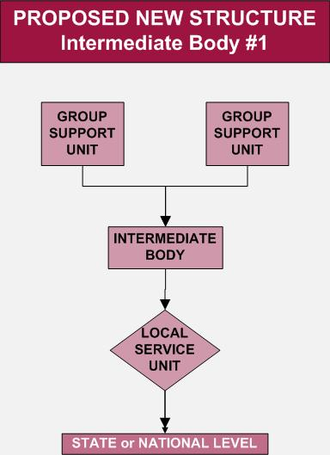
Intermediate body
Reduce travel for rural GSUs
Reduce size of urban LSUs
Allow minority language groups to come together

Slide 23
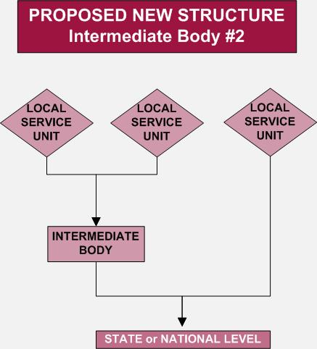
Neighboring LSUs can send delegate(s)
Reduces travel time
Reduces number of delegates in large state/national body

Slide 24
Intermediate bodies
“Span a gap” where needed. For example, it may not be practical for the California State body to be composed of delegates from all LSUs
Created when the need definitely exists, but that need would be density, distance or language
“Petition” to form, such as WSC seating (needs more discussion)

Slide 25
Intermediate bodies
Not a place-holder to retain existing structure. Needs-based
Not shared services in the sense that it exists between LSU and State, not between two LSUs
More discussion, creativity, experience is needed to further define this level

Slide 26

State or national service unit
Consists of a state, province, or country
Could consist of neighboring states, provinces, or countries for seating purposes
Provides services that cover the whole state, province, or country
Border communities may join neighboring states if practical

Slide 27
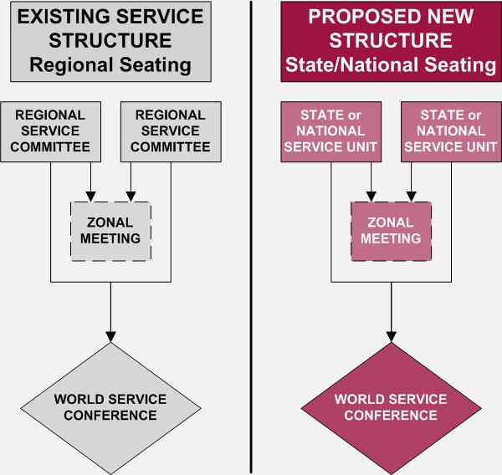
Existing or proposed seating option

Slide 28
Intended services
State/national service bodies:
Interact with government and professional bodies
Organize assemblies and conventions
Coordinate centralized resources
Provide a communication link

Slide 29
State, national or province
Basic model going in: US States, Canadian Provinces, Nations elsewhere
Identify “anomalies” in this, such as perhaps Brazil, Mexico, Russia and make appropriate adaptations
Additional anomalies may be, for example, New England or other smaller states which could combine
Need more definition about what constitutes a “state” versus a “nation”

Slide 30
Wsc seating
We will be recommending a seating model based on state/national/province service bodies
This model may have a shelf life due to the size of the WSC, but seems most practical at this time
We will continue to explore something like a “zonal” seating model
  “Zones” as we now know them might need to be revamped to make such a model workable

Slide 31
Processes (next phase)
Still need concrete, documented processes, and have made some progress, but this continues to be a major focus of the next cycle
Cyclical planning processes, leadership development processes, communications processes, delegation processes, decision-making processes and information management process. Much work to be done on these.

Slide 32
Issues to resolve
Fund flow, including how GSU is funded (if the GSU needs funds)
Literature distribution
Legal issues: Corporations, insurance, RSO’s
Synching planning cycles throughout the system

Slide 33
Issues to resolve
Who creates intermediate bodies?
Who determines LSU boundaries?
How do shared services committees work?
State/Nation “Anomalies” and how to identify and resolve
Further seating criteria

Slide 34
Time line of work
Current 4-year project to end at WSC 2012
At WSC 2012, we are planning to offer a set of “agreements in principle” on the direction we’ve discussed
We will propose a project for the 2012-2014 cycle to continue this work
This model matches the “Resolution Group / Transition Group” model used for WS restructuring

Slide 35
questions

